Slide 1

The Role of AI in Capital Asset Management at DCAMM
Anuraag Macha, Anca Pitigoi, Matthew Branum

Slide 2
Executive Summary
This project uses machine learning to enhance how DCAMM forecasts project costs.
Analyzed historical data to identify key cost drivers.
Developed predictive models to improve estimation accuracy.
Highlights factors that contribute to project cost and duration overruns.
Impact
Strengthens financial planning and forecasting capabilities.
Reduces risk of budget overruns and improves resource allocation.
Establishes a scalable foundation for future AI integration in capital project management.

Slide 3
Business Problem
Ongoing challenges
Fluctuating material and labor costs
Inflation and economic uncertainty
Project delays that increase total costs
Project Goals
Identify key cost drivers using historical spending data
Build and compare machine learning models: • Linear Regression (baseline) • XGBoost (tree-based) • Artificial Neural Networks (deep learning)
Deliver a forecasting dashboard and documentation

Slide 4
Project Timeline
Feature Engineering
Model Development
Model Evaluation
Visualization and Presentation
Conclusion and Submission
By Feb. 23
Accomplished for ML models that require additional features.
By March 16
Models include linear regression, XGBoost, Random Forests, and Artificial Neural Networks.
By March 23
Including testing for overfitting, troubleshooting errors, and testing validity, accuracy, and precision.
By March 29
Finalizing project presentation and creating dashboard to visualize insights.
By March 29
Finalize any adjustments to the project deliverable and submit to sponsor and instructor.

Slide 5
Data Sources and Preprocessing
Data Sources
Summary dataset: Aggregated costs, project durations, and locations.
Detailed dataset: Cash flow expenses down to the cent.
Data Cleaning & Feature Engineering
Removed missing or redundant features.
Standardized currency formats and adjusted for inflation.
Mapped locations to Massachusetts Congressional Districts.
Created new cost-related features to enhance prediction accuracy.

Slide 6
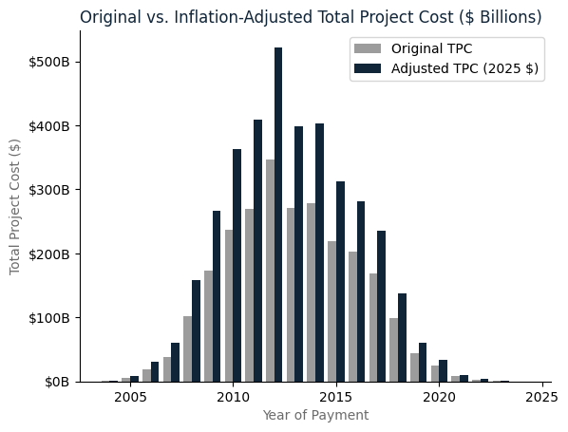
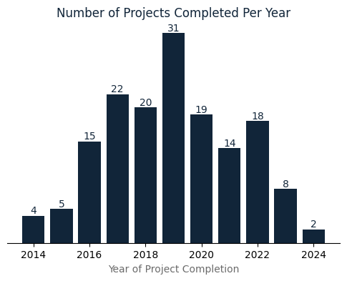
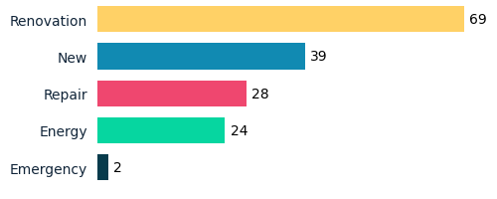
Key Insights
Inflation-Adjusted Costs:
Project Completion Trends:
Cost Differences by Project Type:
Construction costs have risen significantly.
Largest inflation gap is in 2012.
Peak in 2019, followed by declining completed projects.
Indicates economic shifts, funding changes, and industry slowdowns.
Most projects are renovations.
Only two emergencies in 20 years.

Slide 7
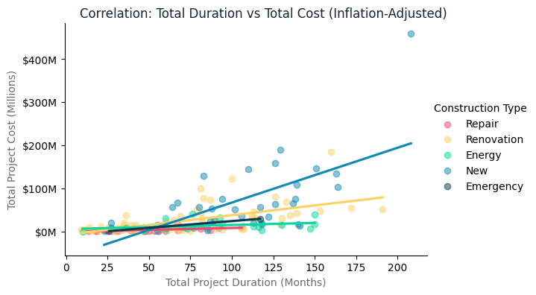
Continued Key Insights
Project duration is a strong predictor of cost.
New construction projects exhibit sharp cost increases.
Energy projects with longer durations see slower cost growth.
Emergency correlation is not reliable.

Slide 8
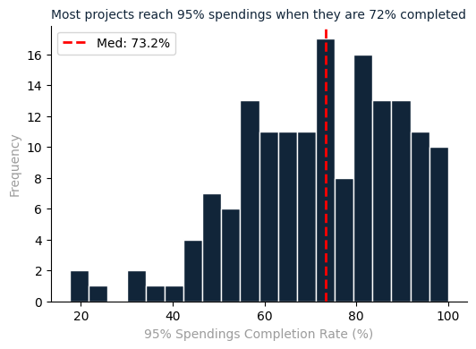
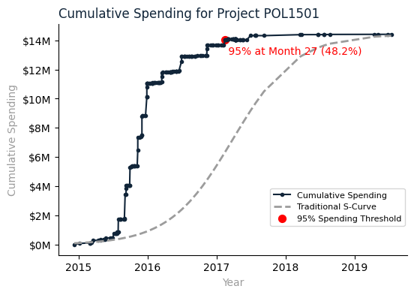
Project Spending Patterns – S-Curve Analysis

Slide 9
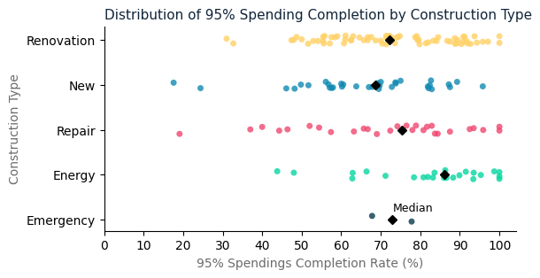
Spending Completion by Construction Type
Renovation:
Spending occurs later in the timeline
Median near 70% completion — projects often stay active longer
New Construction:
Spending is spread out with some early peaks
Median completion around 60%
Repair & Energy Projects:
Tend to complete spending earlier
Median closer to 75–85%
Emergency Projects:
Not enough projects to draw reasonable conclusions
Notes:
This chart shows when 95% of funds are typically spent across different types of construction projects:

Slide 10
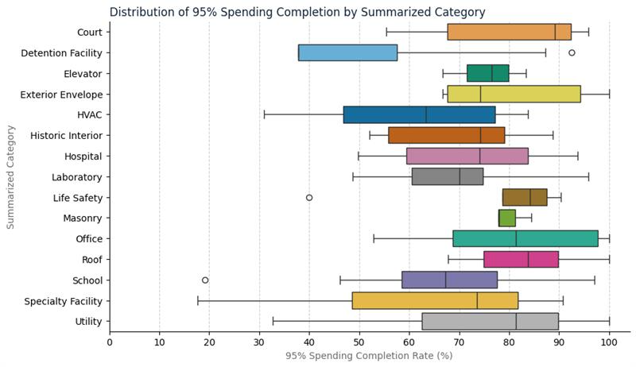
Spending Patterns by Project Category
Key Insights
Courts, Offices, and Roofs spend 95% later in the timeline — closer to 80–90% project completion.
Detention Facilities show the earliest spend-down, hitting 95% at just ~38% completion.
HVAC, Specialty Facilities, and Utilities show the widest variation, indicating unpredictable spending patterns.
Laboratory and School projects tend to cluster tightly around 67–70%.

Slide 11
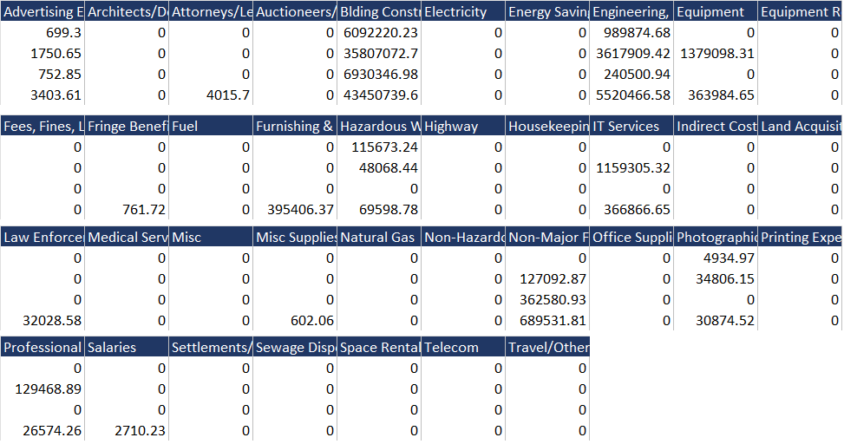
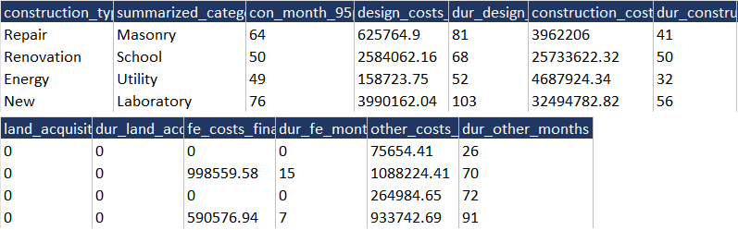
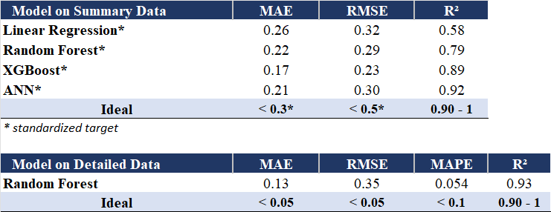
Model Performance
Mean Absolute Error: Measures average prediction error.
Root Mean Squared Error: How much predictions deviate from actual values.
R² (Coefficient of Determination): Variance explanation in cost.
Mean Absolute Percentage Error: Average percentage error between predictions and actual values.

Slide 12
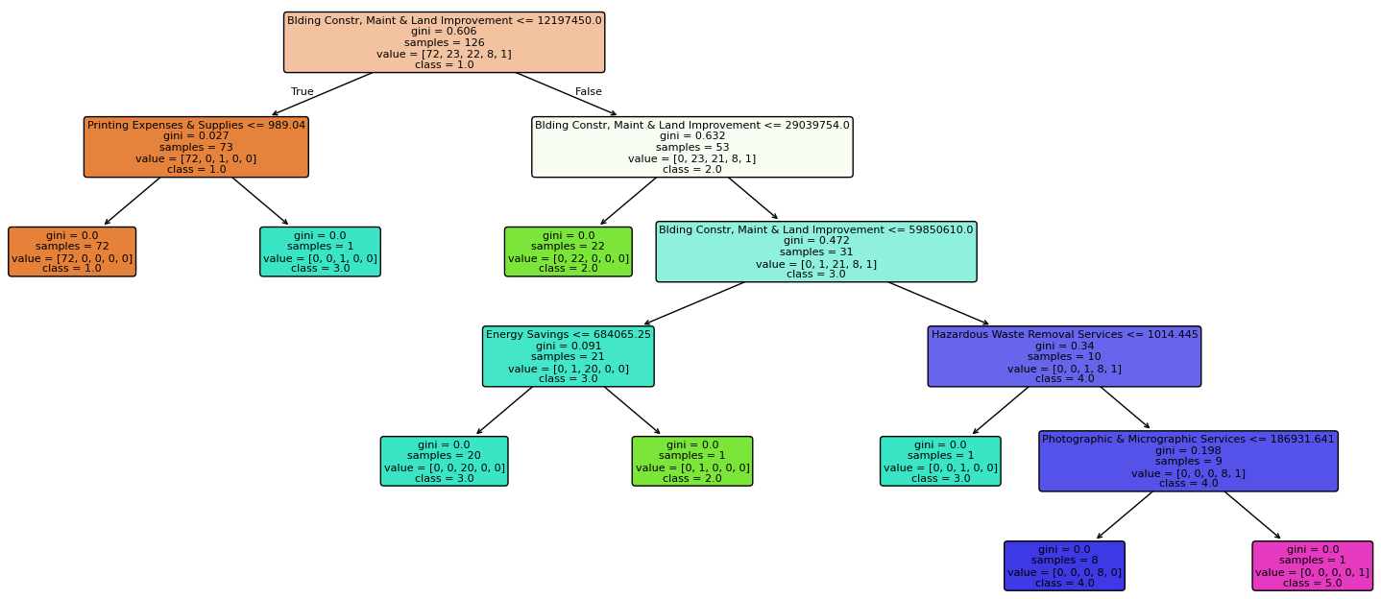
Random Forest Interpretation

Slide 13
Challenges & Limitations
Limited Dataset
Only 160 projects over a decade → potential overfitting risks.
Feature Selection Constraints
Lack of pre-project indicators (e.g., square footage, number of levels).
AI models currently rely on post-completion financials.
Model Interpretability
AI models, especially ANNs, need explainability tools for adoption.
Due to the limitations with the model, we decided to focus on spending trends and deliver a dashboard.

Slide 14
Conclusions
Historical data revealed trends in spending and timelines.
Random Forest model on detailed data performed best.
Strong accuracy for post-construction cost predictions.
Main limitation: same level of detailed cost information must be available in advance.
Future models should include early-stage planning features.
Collaborate with other states to expand the dataset - costs can be adjusted for MA.
ML can support smarter budgeting and capital planning with adequate data.

Slide 15
Thank you for your attention!
Anuraag Macha, Anca Pitigoi, Matthew Branum

